Slide 1
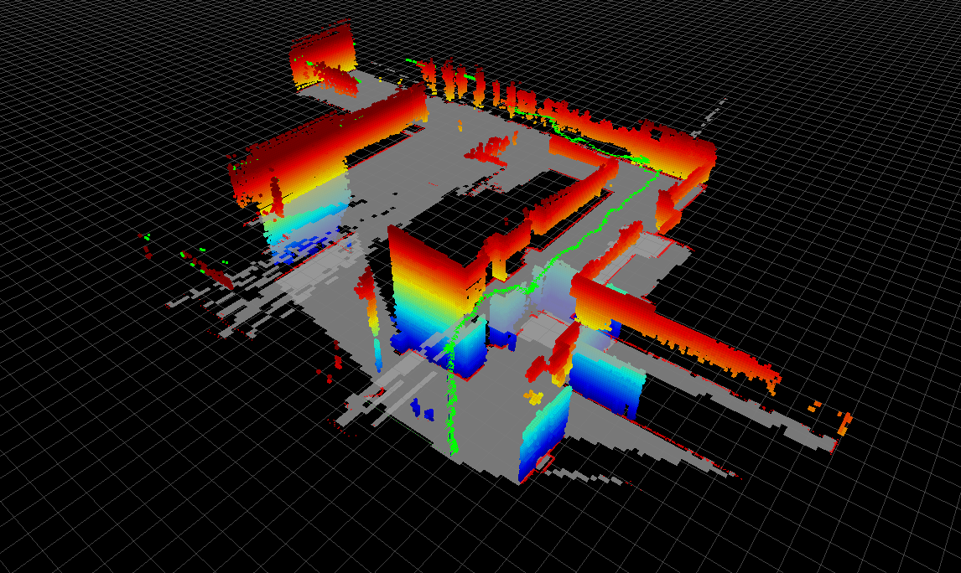
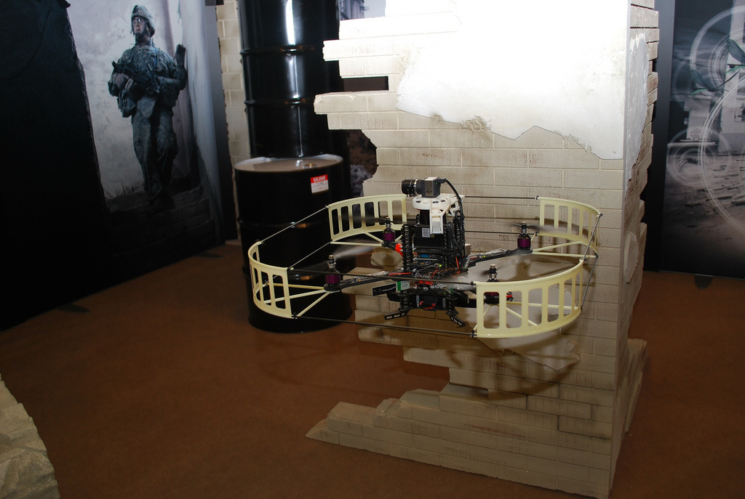
Autonomous Multi-Floor Indoor Navigation with a Computationally Constrained MAV
Shaojie Shen, Nathan Michael, and Vijay Kumar
GRASP Lab, University of Pennsylvania
Notes:
Good morning everyone, I am shaojie shen from the grasp lab at the university of pennsylvania.
Today I am going to talk about the work that I done with my advisors nathan michael and vijay kumar,
the topic is autonomous multi-floor indoor navigation with a computationally constrained micro aerial vehicle

Slide 2
Overview
Goal:
Autonomously navigate through complex 3D indoor/outdoor GPS-denied environments with aerial robots across multiple floors
Localization, mapping, planning, control, exploration
Applications:
Surveillance, search and rescue
Key contributions:
Autonomy
Operates in unknown multi-floor environments
All processing onboard, no external infrastructure required
Aerial robot
Stable control in different environments
Compensates for aerodynamic effects
Notes:
We are interested in using autonomous robots in missions such as surveillance, search and rescue, in complex 3D indoor/outdoor GPS-denied environments across multiple floors
Aerial robots are particularly suitable for these applications since it can easily travel through buildings with multiple floors and stairwells.
In order to achieve the required level of autonomy, we developed a aerial navigation system with localization, mapping, planning, control, exploration modules.
Since wireless signal can be easily blocked across multiple floors, we require all these functions to be performed fully onboard without any external infrastructure. Through the development of our system, we put lots of efforts to optimize the algorithm, and make reasonable approximations to reduce computation requirements. This is the key contribution of this work.
we also developed a method to estimate and compensate external wind gust and down wash from the ceiling in order to enable stable indoor flight

Slide 3
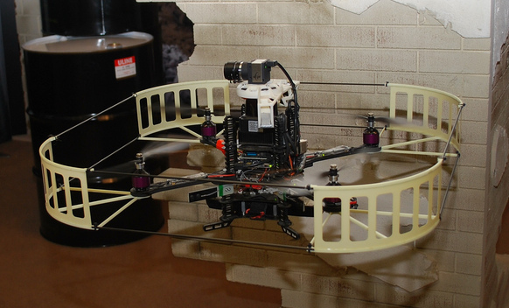
Overview
Pelican quadrotor, Ascending Technologies
~750g payload
~10min flight time
Sensing
IMU
Hokuyo UTM-30LX laser scanner
uEye monocular grayscale camera
Deflective mirrors
Computation
Intel Atom 1.6GHz CPU
1GB RAM
8GB SD card
IEEE 802.11s wireless mesh network
Notes:
We use a quadrotor purchased from Ascending Technologies as our base platform.
We outfitted the platform with a Hokuyo laser scanner, a monocular camera, and a set of mirrors that deflect some of the laser scans to sense the distance from the robot to the floor and ceiling.
The computation on this small scale platform is very limited. It is a 1.6GHz atom processor with 1GB Ram and 8GB SD card.

Slide 4
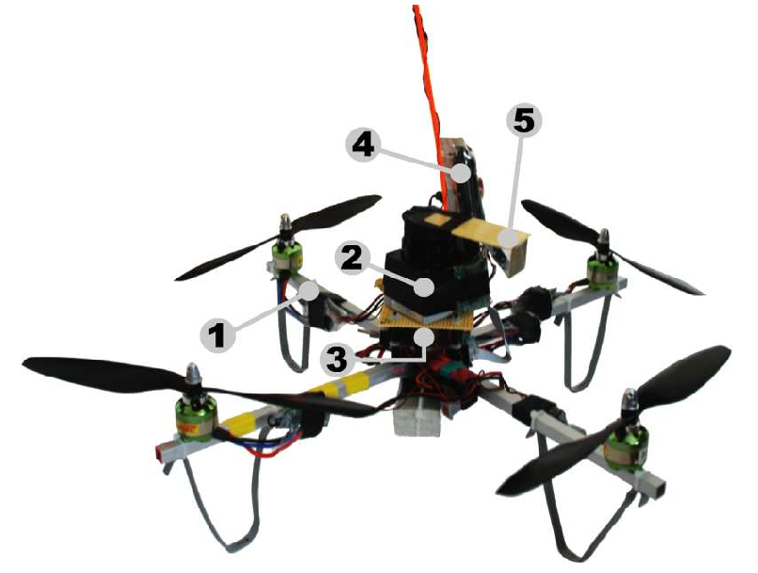
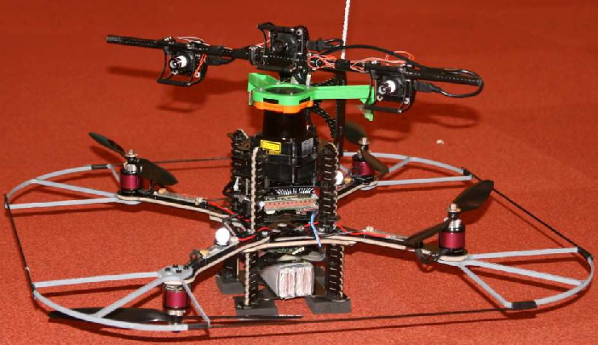
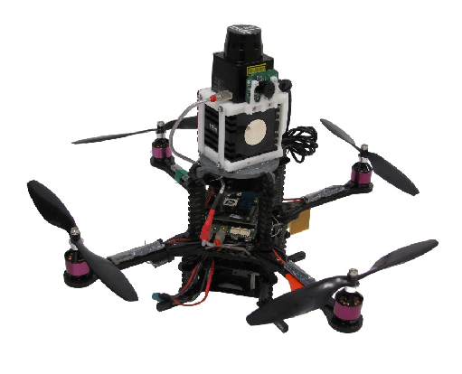
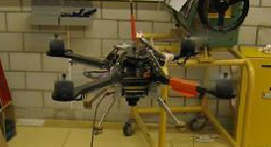
Related Works
S. Grzonka, et al. (U of Freiburg) [ICRA2009]
First trial on laser based indoor flight
Offboard processing
A. Bachrach, et al. (MIT) [EMAV2009]
Laser + Vision + Particle filter based SLAM
Operates on single floor
Offboard processing
W. Morris, et al. (CCNY) [IROS2010]
Laser + Particle filter based SLAM
Offboard Processing
M. Blosch, et al. (ETH) [ICRA2010]
Vision only SLAM
Offboard processing
Notes:
There have been different research groups trying to address the problem of autonomous aerial navigation with laser based sensing techniques, including teams from MIT, U of Freiburg, CCNY.
Despite the fact that it shares some similarity between these approaches and our system, we are the only team that is able to operate across multiple floors.
Our fully onboard processing approach eliminates any worry the unreliable data link to external base stations, which is usually the case in a multi-story buildings.
There are also vision based UAV platforms, such as the one developed at ETH. However, we still choose to use the laser based method because of computation constrains

Slide 5
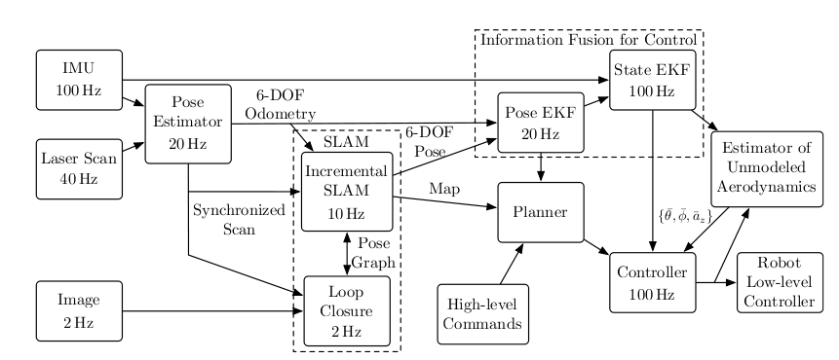


System Design
System block diagram
Estimation, Control (ICRA2011)
Planning, Exploration (IROS2011, Submitted)
Notes:
Here is the overall block diagram of our system. There are two major components, Estimation and control. They are the focus of this talk.
We do move forward on 3D planning, and exploration since the ICRA submission. These parts will be discussed in the IROS paper if it get accepted.

Slide 6
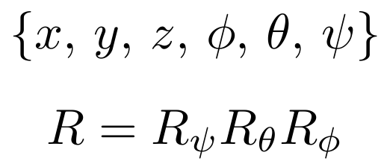
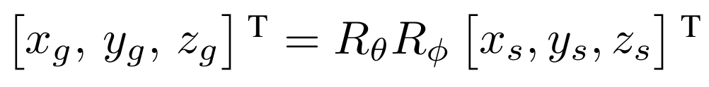
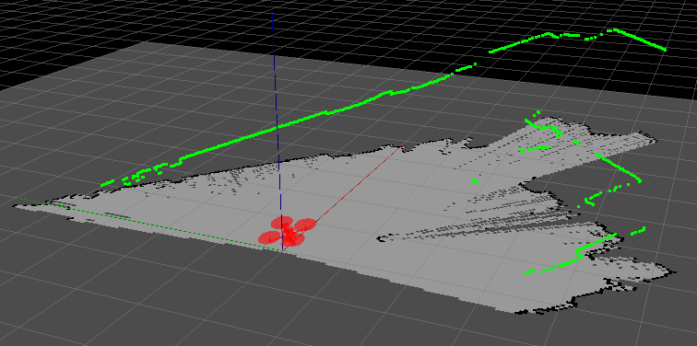
System Design
Assumptions
6-DOF pose – 3D position & roll, pitch, yaw Euler angles
2.5D environment for pose estimation
Project laser scans onto common ground plane
Notes:
I would like to mention the fundamental assumptions in our system.
We estimate full 6DOF pose of the robot.
However, since our platform only have 2D laser scanner, we make a 2.5D environment assumption which make use of the fact that common indoor environments mainly consists of vertical walls or other vertical columns.
We can then project the laser scans to a common ground plane, as shown in the figure, in order to estimate motion in the XY plane

Slide 7

System Design - Estimation
System block diagram
Notes:
A laser based pose estimator provides 6DOF pose

Slide 8
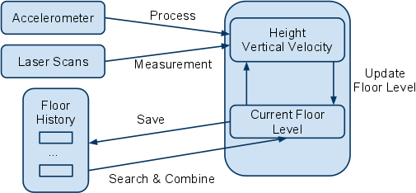
System Design - Estimation
Incremental motion estimation (laser odometry)
Iterative closest point (ICP) based 2D scan matching for x, y, yaw motion
Grid based closest point search to improve speed
20Hz, ~20% CPU usage
Height & floor level estimation
A Kalman filter fuses IMU and deflected laser scans
Update floor level if there are significant differences between process and measurement update
Notes:
We decouple the 6DOF motion estimation into sub problems.
x, y, and yaw motion is obtain from 2D scan matching using the projected laser scans. We choose Iterative closest point based scan matching algorithm with grid based closest point search method to achieve high accuracy with low computation load.
We use a Kalman filter to fuse the acceleration downward facing laser scan measurements to estimate both height and floor levels. We are able to obtain height estimate in the same reference frame even across multiple floors.
Roll and pitch angles can be obtained directly from IMU.

Slide 9

System Design - Estimation
System block diagram
Notes:
A SLAM module is able to correct accumulated errors in laser pose estimator and provide globally consistent maps.

Slide 10
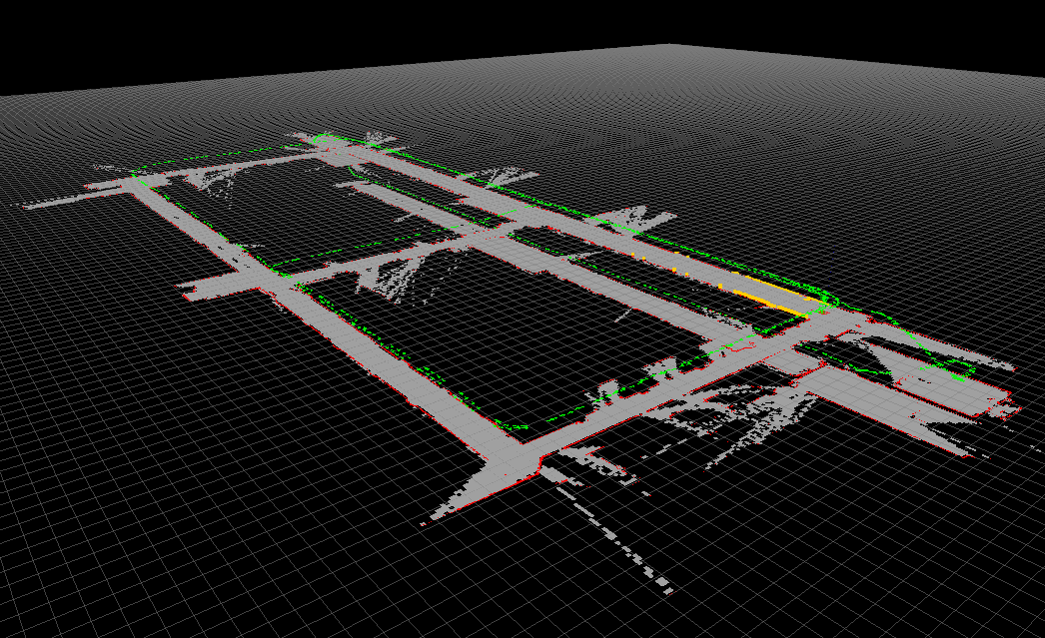
System Design - Estimation
SLAM
Incremental SLAM, efficiency is of first priority
Particle filter-/Feature-based SLAM will not work due to computation constrains
Use image distance transform in OpenCV to compute the costmap for laser scan alignment
10Hz, ~30% CPU Usage
Multi-layered 2D occupancy grid maps to represent multi-floor environments
Sparse samples of pose history and their scan, image features are stored for loop closure
Notes:
Given limited computation power, efficiency is the key focus of our SLAM system. Particle filter or feature based SLAM, althought give good performance, does not meet our computation constrains
We start off by considering standard SLAM techniques that represent the trajectory of the robot as a form of pose graph and generate multi-layered 2D occupancy grid map based on the pose graph.
Pose graph is generated by incremental scan alignment using an approximated costmap that computed from image distance transform.
Pose nodes in the graph is associated with laser scans and image features in order to detect and close loops.

Slide 11
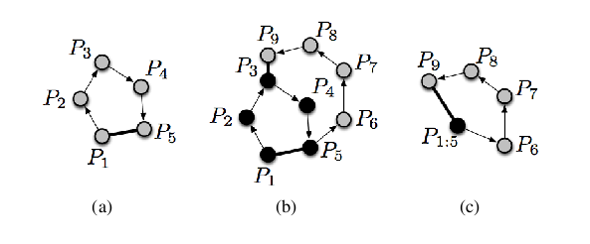
System Design - Estimation
SLAM
Loop closure
Detect SURF features and convert into visual words
Image histogram voting for place recognition
Scan matching to verify loop closure and find relative pose transform
IEKF based optimizer
Approximations to further improve speed
Notes:
Loops are detected using visual information. We extract salient SURF features in the image, convert them to visual words and perform place recognition. We extract relative transform using scan matching. An iterative extended kalman filter based optimizer is then applied to refine the graph structure.
We use additional approximations to reduce the size of the graph, as shown in this figure, as shown in this figure

Slide 12
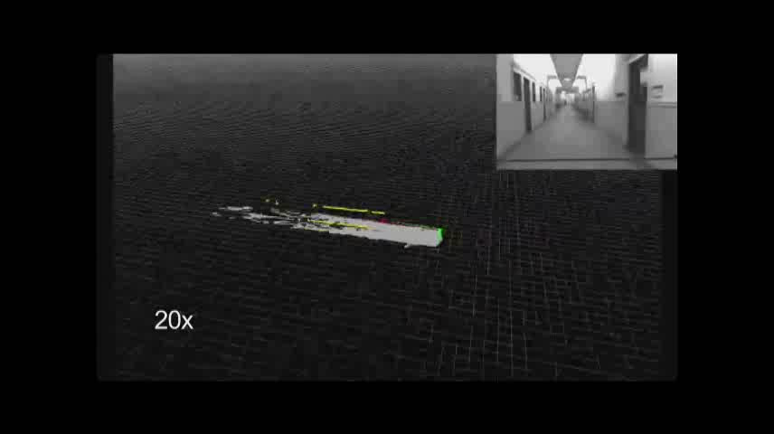
System Design - Estimation
SLAM
Notes:
Loops are detected using visual information. We extract salient SURF features in the image, convert them to visual words and perform place recognition. We extract relative transform using scan matching. An iterative extended kalman filter based optimizer is then applied to refine the graph structure.
We use additional approximations to reduce the size of the graph.
As illustrated in the figures. The robot first close a inner loop P1 to P5. Then it close a outer loop P5 to P9. In this case, we consider the already closed loop P1 to P5 as a rigid point and create a shortcut for it. So the actual number of nodes in the outer loop is shown in (c).
This approximation have the limitation that it may discard some graph constrains, lead to a sub-optimal solution. However, in practice, we found this have minimal effect on the overall performance of the system.

Slide 13

System Design - Estimation
System block diagram
Notes:
The pose estimation from SLAM is not sufficient for feedback control. We add an information fusion unit for high bandwidth, low latency pose and velocity estimate.

Slide 14
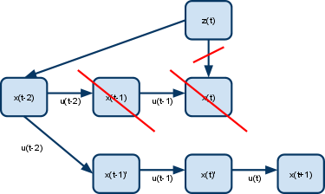
System Design - Estimation
Information fusion for control
Controller requires 100Hz low latency pose and velocity feedback
Two stages of EKFs
10Hz SLAM pose + 20Hz laser odometry
Information is coupled
Delayed measurement update
Handles large delay in SLAM (e.g. Loop Closure) without increasing latency in pose estimation
20Hz Pose + 100Hz IMU
Estimates pose and velocity
Notes:
We use two stage Extended Kalman filters.
In the first EKF, we use a delayed measurement update technique to fuse information from laser odometry and SLAM to handle the possible large delays in SLAM, such as those caused by loop closure. Therefore, we allow the time consuming components to run in the background and it will not block the state estimate.
The second EKF fuses the output from the first EKF and IMU information in order to provide both position and velocity estimate at high frequency.

Slide 15

System Design - Control
System block diagram
Notes:
Now we can use the estimations for feedback control of the robot.

Slide 16
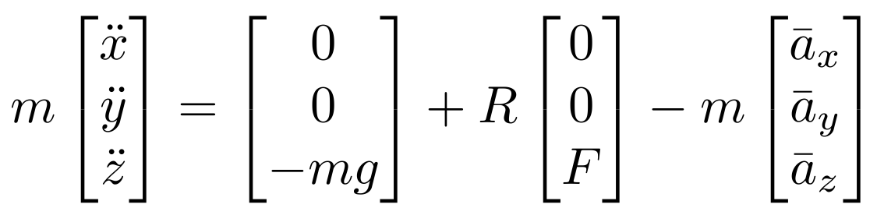
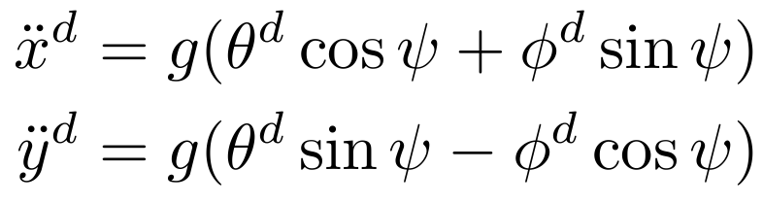
System Design - Control
System model with external disturbance:
Linearize about the near hover state, get relation between roll, pitch and desired linear acceleration:
LQR gains for position control from MATLAB control toolbox
Customized attitude stabilization, tuned using Vicon
Notes:
We model the quadrotor as a second order system with external disturbance forces.
We then linearized the system about near hover state and obtain the relation between the desired linear acceleration and the roll, and pitch angles. We can perform position control of the robot by rolling and pitching with LQR gains found using MATLAB control toolbox
The desired roll and pitch angles are send to the customized attitude stabilization controller of the robot. Gains are fine tuned using a Vicon motion capture system.

Slide 17
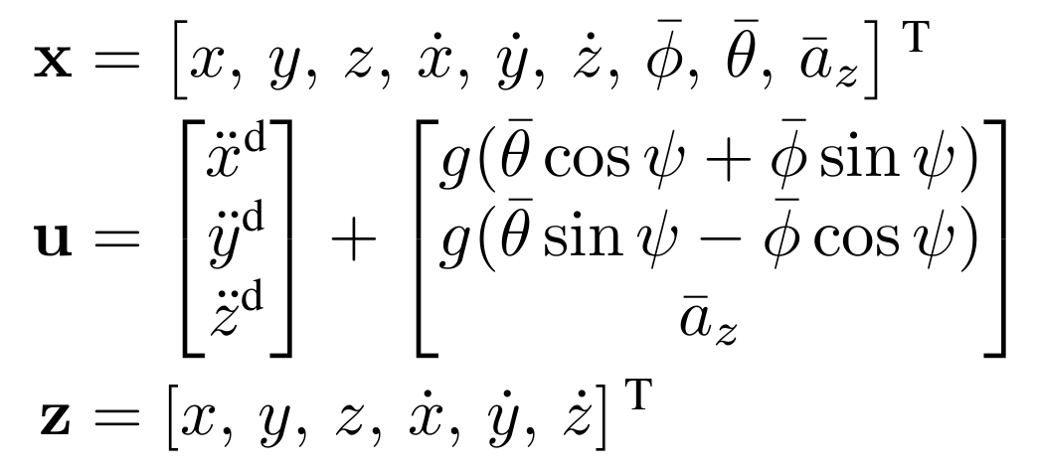
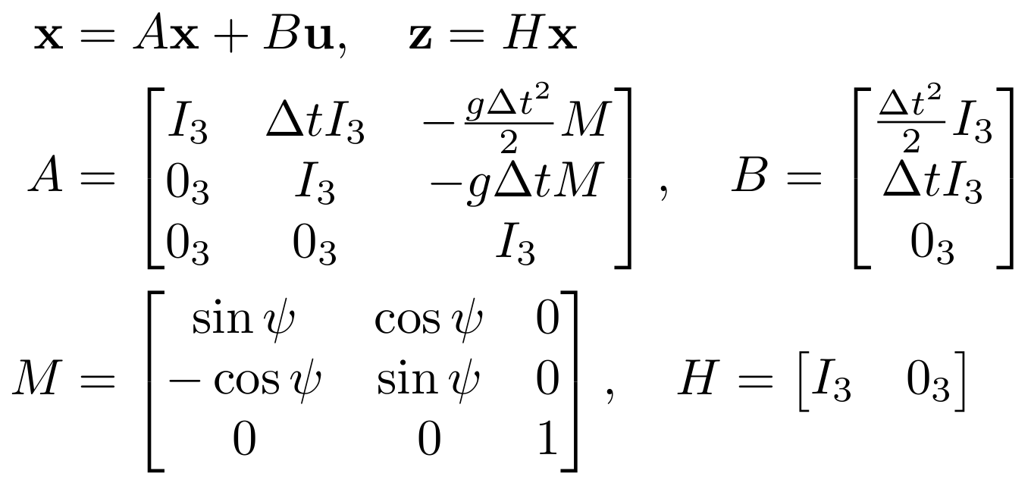
System Design - Control
Estimating and compensating for unmodeled aerodynamic effects
Kalman filter based
Estimate roll, pitch and thrust trim values
State, process and measurement input:
System model:
Notes:
We treat the aerodynamic disturbance applied to the robot as hidden roll, pitch and thrust trim parameters.
A linear Kalman filter is then use to try to match the desired control response with the actual system state by estimating these trim parameters.
As shown here, The process model is the desired acceleration of the robot plus the additional force compensation terms generate from the trim parameters.
The measurement model is the pose and velocity feedback coming from the estimation module.

Slide 18
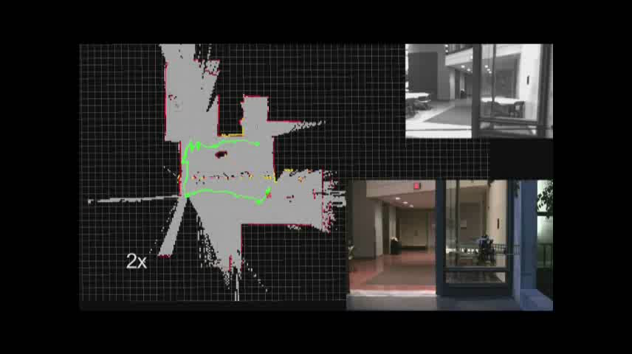
System Design - Control
Estimating and compensating for unmodeled aerodynamic effects
Notes:
We treat the aerodynamic disturbance applied to the robot as hidden roll, pitch and thrust trim parameters.
A linear Kalman filter is then use to try to match the desired control response with the actual system state by estimating these trim parameters.
As shown here, The process model is the desired acceleration of the robot plus the additional force compensation terms generate from the trim parameters.
The measurement model is the pose and velocity feedback coming from the estimation module.

Slide 19
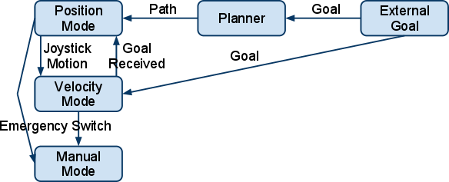
System Design - Safety
Safety is critical
No protection nets
No ground truth pose feedback
High power motors
Safety controller
Finite state machine for seamless switching between position/velocity/manual mode
Notes:
Finally, to ensure that our robot can operate safely in common indoor environments, we design a finite state machine based safety controller.
This controller can seamlessly switch between different level autonomy in order to meet both safety and mission completion requirements.

Slide 20
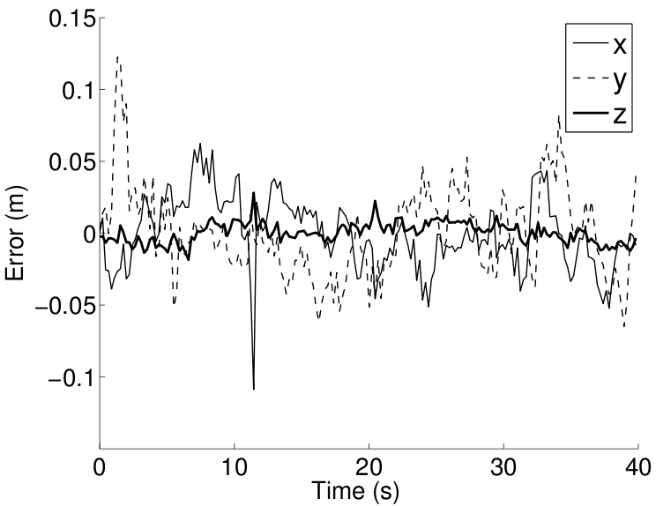
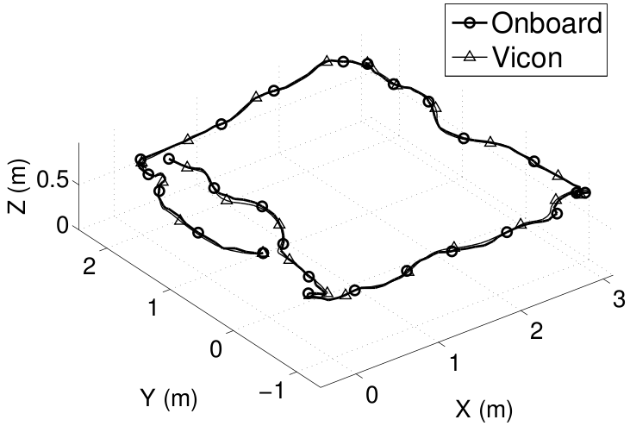
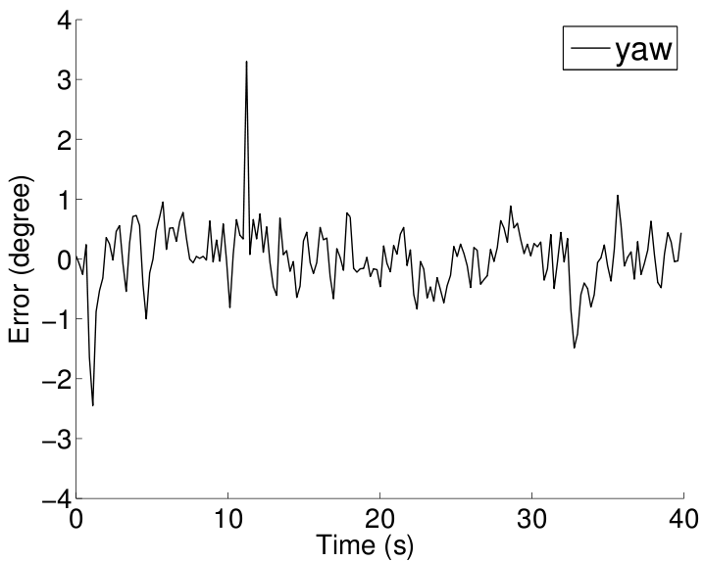
Results - Pose Estimation
Ground truth reference from Vicon
Standard Deviation:
x: 2.47 cm
y: 3.23 cm
z: 0.70 cm
yaw: 0.55 degree
Notes:
We now show the pose estimation performance of our system. This experiment is conducted in a lab with Vicon as ground truth reference.
While following this rectangular trajectory, the position estimation error is on the order or a few centimeters, and the yaw estimation error is less than one degree. This is sufficient for closed loop control of the robot.

Slide 21
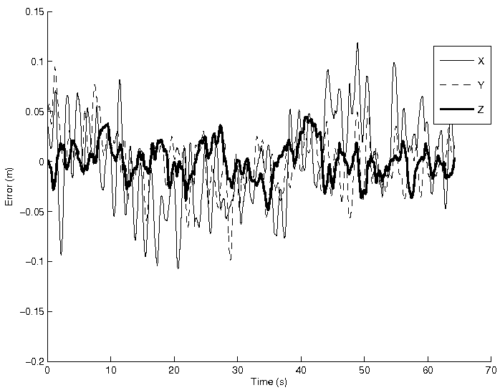
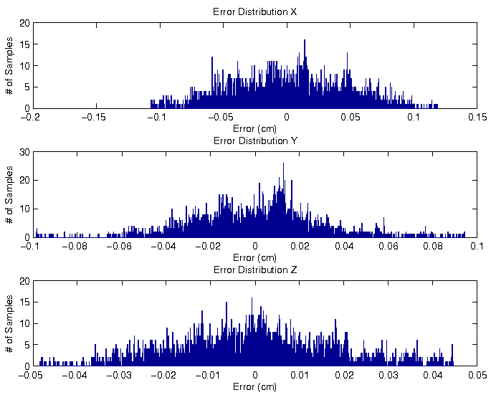
Results - Hover Performance
Feedback control using onboard pose and velocity estimation
Ground truth reference from Vicon
Standard Deviation:
x: 4.42 cm
y: 2.79 cm
z: 1.76 cm
Notes:
Then we use our onboard pose and velocity estimation as feedback to hover the robot in an environment without wind.
We see the standard deviation on the hover error on par with the pose estimation error. This suggests that we have an appropriated controller.

Slide 22
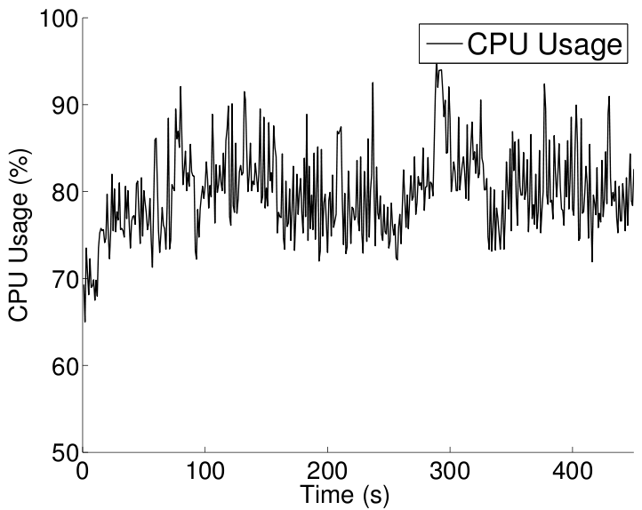
Results - CPU Usage
All computations (estimation, planning, control) running onboard
Notes:
With all computations running, the CPU usage of our system on a 1.6GHz atom processor takes approximately 80% of the CPU power.

Slide 23
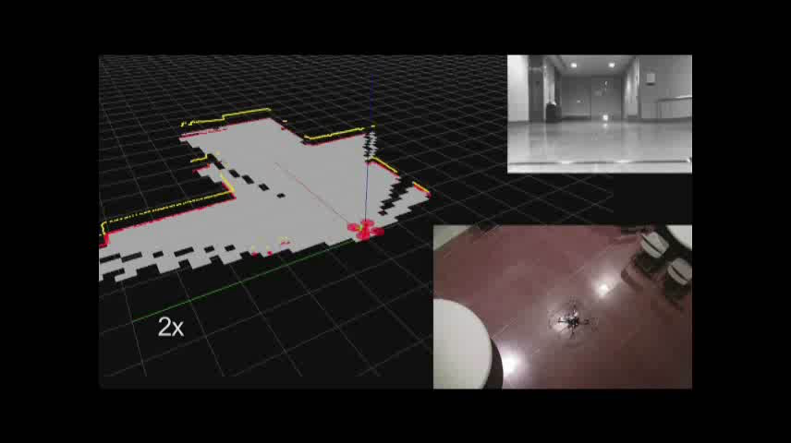
Results – Multi-floor Indoor Experiment
All computations (estimation, planning, control) running onboard
Software developed in c++ under Linux using ROS as middleware
Notes:
After confirming that the system performance meets our design requirement, we design three sets of experiments at the campus of the University of Pennsylvania to demonstrate the overall performance.
All computations, running onboard the robot. No external infrastructure is needed.
The first experiment is conducted in a multi-floor building. The robot is able to close a multi-floor loop and built maps of each floor accurately.
The second experiment aims to show that the robot is able to handle wind gust that results from the transitioning between indoor and outdoor environment.
The third experiment shows that the SLAM algorithm is capable to map a large scale multi-story environment with size well beyond the feasible flight time of the robot. Loop closure maintains the map consistency across multiple floors.

Slide 24
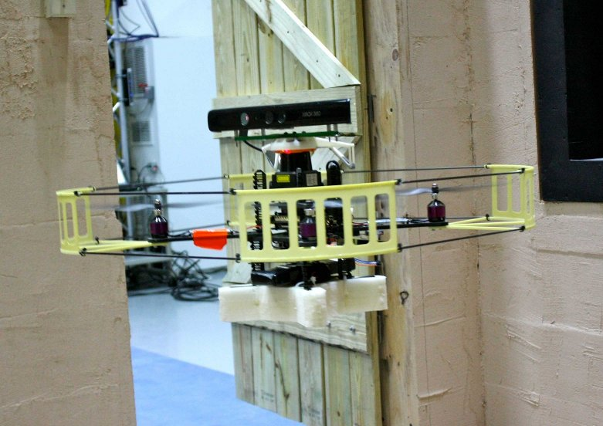



Conclusions
Autonomous quadrotor aerial robot
Operates in GPS-denied multi-floor unknown indoor environments
Pose and velocity estimation at 100Hz with low latency
SLAM with vision based loop closure
Controller with external disturbance compensation
All computations onboard, no external infrastructure required
Notes:
In this paper, we presented our autonomous quadrotor aerial robot platform.
Our system is able to perform autonomous navigation in multi-floor unknown indoor environments with pose estimation, SLAM, and control all running onboard the robot without requiring any external infrastructures.
This pictures again shows our robot .This quadrotor is slightly different from the other one as it has a Kinect sensor on it. This is because we are moving towards higher level of autonomy with 3D explorations.

Slide 25
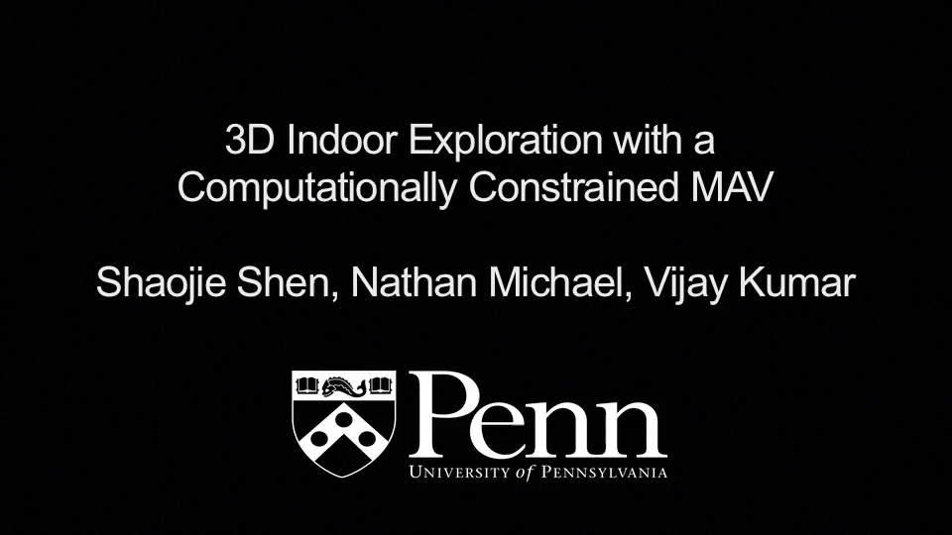
Ongoing and Future Works
Autonomous 3D exploration (IROS2011, Submitted)
Indoor/outdoor operations with laser and/or GPS
Multi-robot cooperative exploration
Notes:
Here shows one of our most recent result on autonomous multi-floor exploration. This robot is fully autonomous and does not require any human interaction.
We are also interested in wider application areas, such as integrating both laser and GPS data to enable both indoor and outdoor operations as well as smooth transitioning between indoor and outdoor environments.
Multiple aerial robot cooperative SLAM and exploration is also a interesting research direction.
Thanks for attending my talk, I will leave this video playing and I am happy to answer any questions.

